Slide 1
Microarchitecture Design & Operation
Suggested Reading: Chapter 4 from Tanenbaum, Structured Computer Organization, 5/6ed, Pearson

Slide 2
The microprogram
IJVM

Slide 3
Objective
At the end of this module you will be able to
Understand, develop, and extend the Mic-1 microprogram

Slide 4
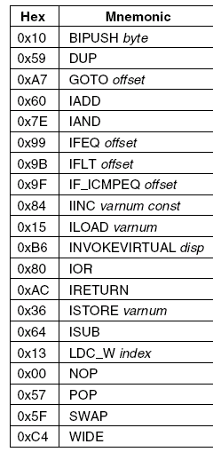
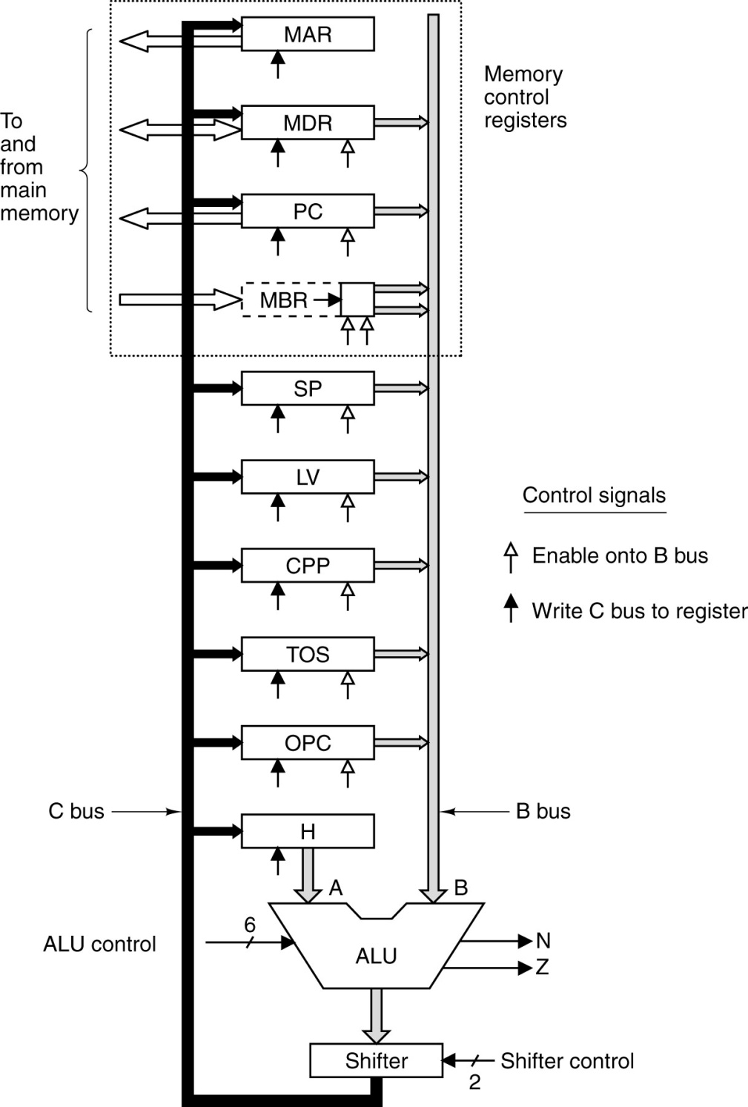
microprogram

Slide 5
Invariants
The following are always maintained
SP points at the top of the stack, before and after each ISA instruction
TOS always contains the value at the top of the stack, before and after each ISA instruction
Each MI always fetches the opcode for the following MI in the program

Slide 6
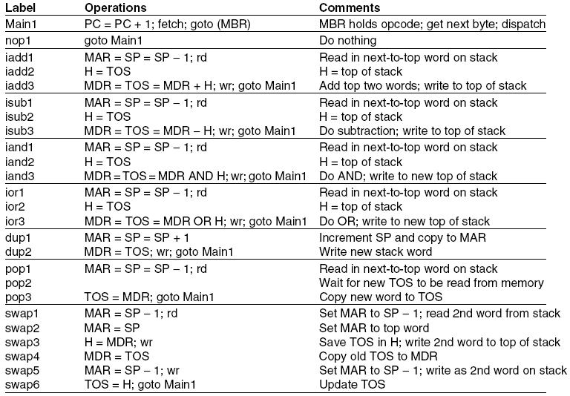
Implementation of IJVM Using the Mic-1 (1)
The microprogram for the Mic-1

Slide 7
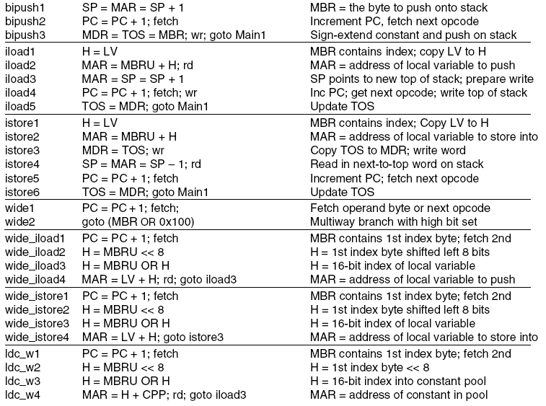
Implementation of IJVM Using the Mic-1 (2)
The microprogram for the Mic-1

Slide 8
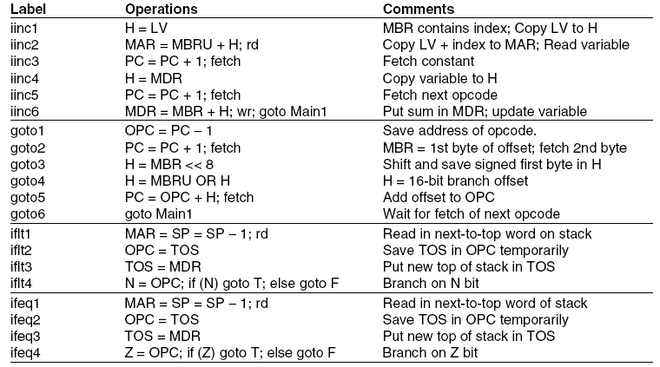
Implementation of IJVM Using the Mic-1 (3)
The microprogram for the Mic-1

Slide 9
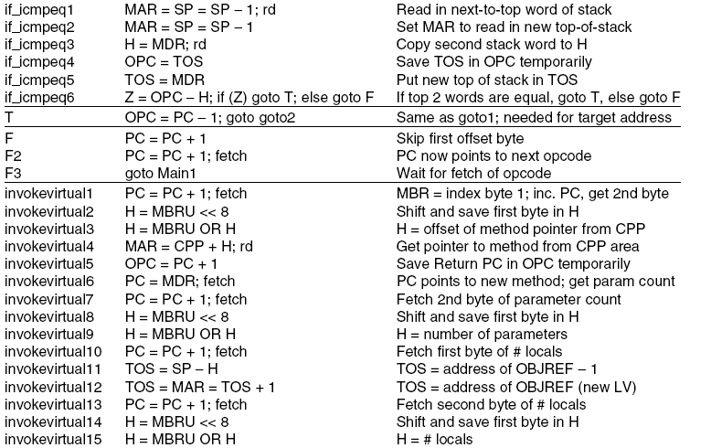
Implementation of IJVM Using the Mic-1 (4)
The microprogram for the Mic-1

Slide 10
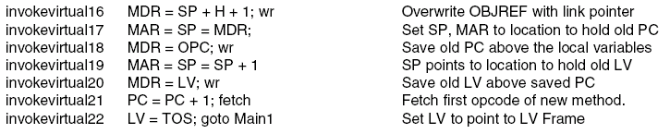
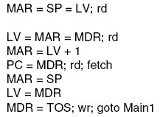
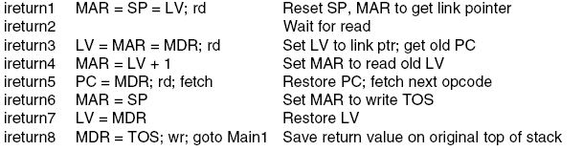

Implementation of IJVM Using the Mic-1 (5)
The microprogram for the Mic-1

Slide 11
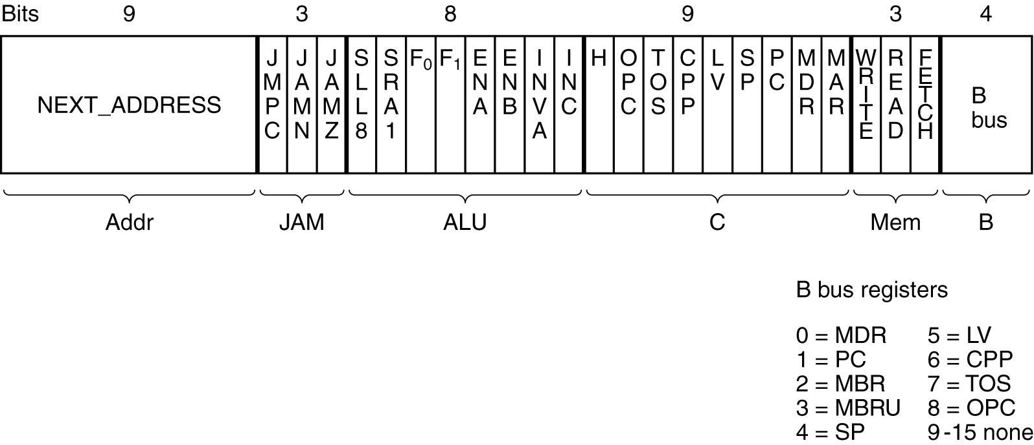
Microinstructions
Best way to specify microinstructions is to give the 36 bit stream
However, this is tough
We will give a HL notation
Better for us to understand

Slide 12
Notation
Each line: activities in a single clock cycle
SP = SP + 1; rd
Read SP onto B-Bus
ALU: add 1 operation
Store back in SP
Initiate a memory read instruction
MDR = Memory[MAR]

Slide 13
Notation
SP = MDR = SP +1
B = SP
ALU + 1
Store result in SP and MDR
MDR = SP; wr
Copy SP into MDR
Start a memory write
Memory[MAR] = MDR

Slide 14
Invalid Instructions
MDR = SP + MDR
Cannot be executed in one cycle
Need 2 cycles:
H = MDR (alternatively H = SP)
MDR = SP + H

Slide 15
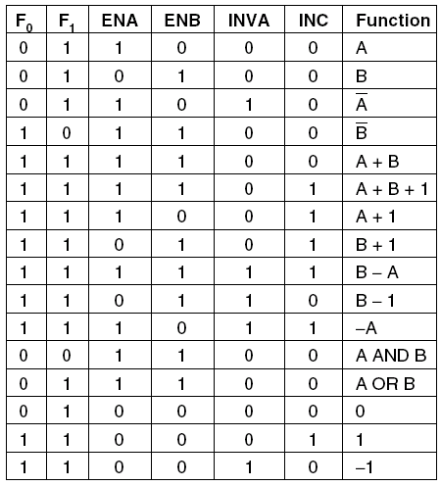
Invalid Instructions
H = H – MDR
Why illegal?
ALU functions

Slide 16
Invalid Instructions
MAR = SP; rd
MDR = H
Illegal:
rd => MDR = Memory[MAR]
Completes at the end of second microinstruction
Second microinstruction also assigns value to MDR
Result: unknown value in MDR
Microassembler must reject such statements

Slide 17
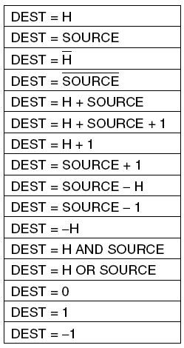
Permitted Microinstructions
All permitted operations.
SOURCE in {MDR, PC, MBR, MBRU, SP, LV, CPP, TOS, OPC} (to B bus)
DEST in {MAR, MDR, PC, SP, LV, CPP, TOS, OPC, H} (from C bus)
Also rd, wr, fetch
Any of the
above operations may be extended
by adding ‘‘<< 8’’ to them to shift the
result left by 1 byte. For example,
a common operation is
H = MBR << 8

Slide 18
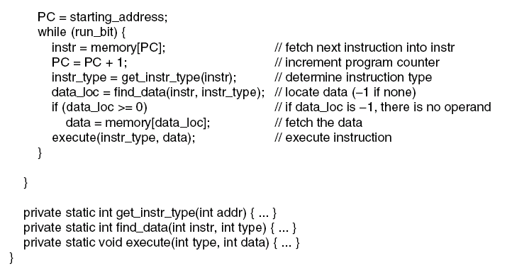
Interpreter
An interpreter for a simple computer (written in Java).

Slide 19
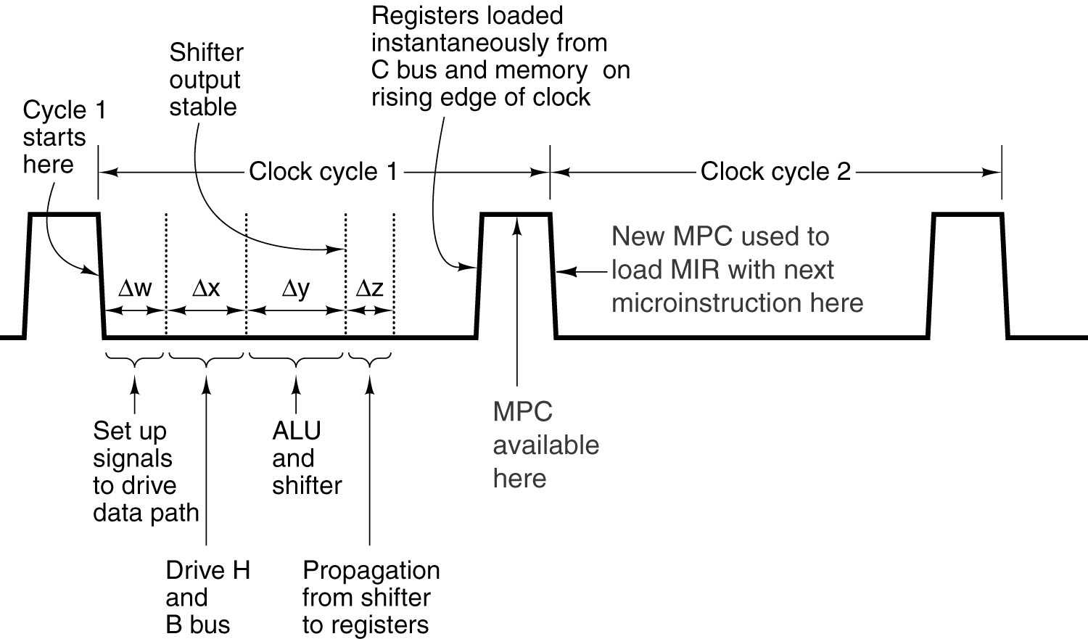
Interpretation
main1 PC = PC + 1; fetch; goto(MBR)
0’s
0001
MPC = NEXT_ADDRESS OR MBR = MBR

Slide 20
Microstore
POP needs three microinstructions
Cannot be fit contiguously in microstore
Every MI must point to its successor
Address | Microinstruction
…
0x10 | Start of microcode to interpret BIPUSH
…
0x57 | Start of microcode to interpret POP
0x58 | ?
0x59 | Start of microcode to interpret DUP

Slide 21
NEXT_ADDRESS
Address | Microinstruction
…
0x57 | First microcode to interpret POP
…
? | Second microcode to interpret POP
…
? | Third microcode to interpret POP
…
Main1 | PC = PC+1; fetch; goto(MBR)
Last MI that interprets an ISA instruction has Main1 as its successor

Slide 22
Interpretation
Main loop of the micro program
main1 PC = PC + 1; fetch; goto(MBR)
main1: label (address)
goto: unconditional branch
Assumes PC has been fetched previously and points to first byte in method area
Typically first byte in main method
PC is incremented and next byte is fetched
Next byte will be ready in MBR at the end of the next microinstruction
May be needed by the third microinstruction

Slide 23
Interpretation
main1 PC = PC + 1; fetch; goto(MBR)
MBR = POP = 0x57
MPC = 0x57
For the next MI

Slide 24
JMPC
If JMPC == 1
MBR OR (bitwize) NEXT_ADDRESS[0..7]
Else
Pass NEXT_ADDRESS as is from previous MI

Slide 25
NOP
No Operation
nop1 goto main1
Do nothing
First microinstruction to be executed
main1

Slide 26
IADD Pop 2 words from stack and add them; push result onto stack
x
y
x+y
S’
S’

Slide 27
IADD – cycle 1 Pop 2 words from stack and add them; push result onto stack
x
SP
x
y
y
SP
, MAR
S’
S’
Need to read y to DP
TOS
x
Read: MDR = Memory[MAR] = y

Slide 28
IADD – cycle 2 Pop 2 words from stack and add them; push result onto stack
y
SP
, MAR
S’
Wait for the read to finish
TOS
x
Mean while copy TOS to H to perform
A+B (TOS=x+MDR=y)
H
x
At the beginning of cycle 3, MDR = y

Slide 29
IADD – cycle 3 Pop 2 words from stack and add them; push result onto stack
End of cycle 4
x+y
SP
, MAR
y
S’
Add MDR and H (x+y)
TOS
x
Need to write (x+y) back to memory:
MDR = (x+y) write
x+y
H
x
Also update TOS to (x+y), new top of stck
MDR
y
x+y

Slide 30
IADD Pop 2 words from stack and add them; push result onto stack
iadd1 MAR = SP = SP – 1; rd; goto iadd2
iadd2 H = TOS; goto iadd3
iadd3 MDR = TOS= MDR+H; wr; goto main1
From now on implicit goto’s will be omitted
Note: iadd1 = 0x60

Slide 31
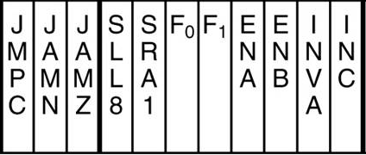
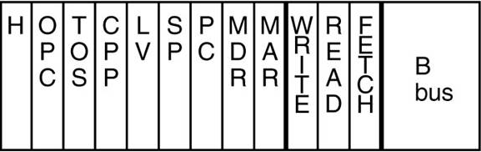
IADD – iadd1
Pop 2 words from stack and add them; push result onto stack
iadd1 MAR = SP = SP – 1; rd; goto iadd2
MIR
iadd2
SP

Slide 32
IADD – iadd2
iadd2 H = TOS; goto iadd3
MIR
iadd3
TOS

Slide 33
IADD – iadd3
iadd3 MDR = TOS= MDR+H; wr; goto main1
MIR
main1
MDR

Slide 34
ISUB
Pop 2 words from stack and subtract them; push result onto stack
isub1 MAR = SP = SP – 1; rd;
isub2 H = TOS;
isub3 MDR = TOS= MDR – H ; wr; goto main1
Note: isub1 = 0x64

Slide 35
IAND
Pop 2 words from stack and and them; push result onto stack
iand1 MAR = SP = SP – 1; rd;
iand2 H = TOS;
iand3 MDR = TOS= MDR AND H ; wr; goto main1
Note: iand1 = 0x7E

Slide 36
IOR
Pop 2 words from stack and or them; push result onto stack
ior1 MAR = SP = SP – 1; rd;
ior2 H = TOS;
ior3 MDR = TOS= MDR OR H ; wr; goto main1
Note: ior1 = 0x80

Slide 37
DUP – cycle 1
Duplicate top word on stack and push onto stack
?
SP
, MAR
x
SP
x
S’
S’
TOS
x

Slide 38
DUP – cycle 2
Duplicate top word on stack and push onto stack
x
SP
, MAR
?
x
SP
x
S’
S’
TOS
x
Write TOS to memory:
MDR
x
Copy TOS to MDR
Memory[MAR] = MDR = x

Slide 39
DUP
Duplicate top word on stack and push onto stack
dup1 MAR = SP = SP + 1;
dup2 MDR = TOS; wr; goto main1
Note: dup1 = 0x59

Slide 40
POP
Delete word from stack
pop1 MAR = SP = SP – 1; rd;
pop2
pop3 TOS= MDR; goto main1
Note: pop1 = 0x57

Slide 41
POP – pop2
pop2
Simply: goto pop3
NEXT
ADDRESS
pop3
none

Slide 42
SWAP
Swap top of stack word with next-to-top word
swap1 MAR = SP – 1; rd;
swap2 MAR = SP
swap3 H = MDR; wr
swap4 MDR = TOS
swap5 MAR = SP – 1; wr
swap6 TOS = H; goto main1
Note: swap1 = 0x5F

Slide 43
Exercise
Write an implementation in MAL for a hypothetical IJVM instruction DNTT
Duplicate Next To Top
Duplicates the next-to-top value on the stack and push onto stack

Slide 44
Instructions with Operands

Slide 45
Fetching a head
…
1) IADD
2) DUP
3) ISUB
main1 PC = PC + 1; fetch; goto(MBR)
PC = 1, MBR = IADD
PC = 2, fetch DUP to MBR
Interpret IADD
End of add1: MBR = DUP
When IADD finishes, goto main1
PC = 3, fetch ISUB, goto dup1
End of dup1: MBR = ISUB

Slide 46
BIPUSH byte
Push byte onto stack
BIPUSH 1
DUP
What does MBR contain?

Slide 47
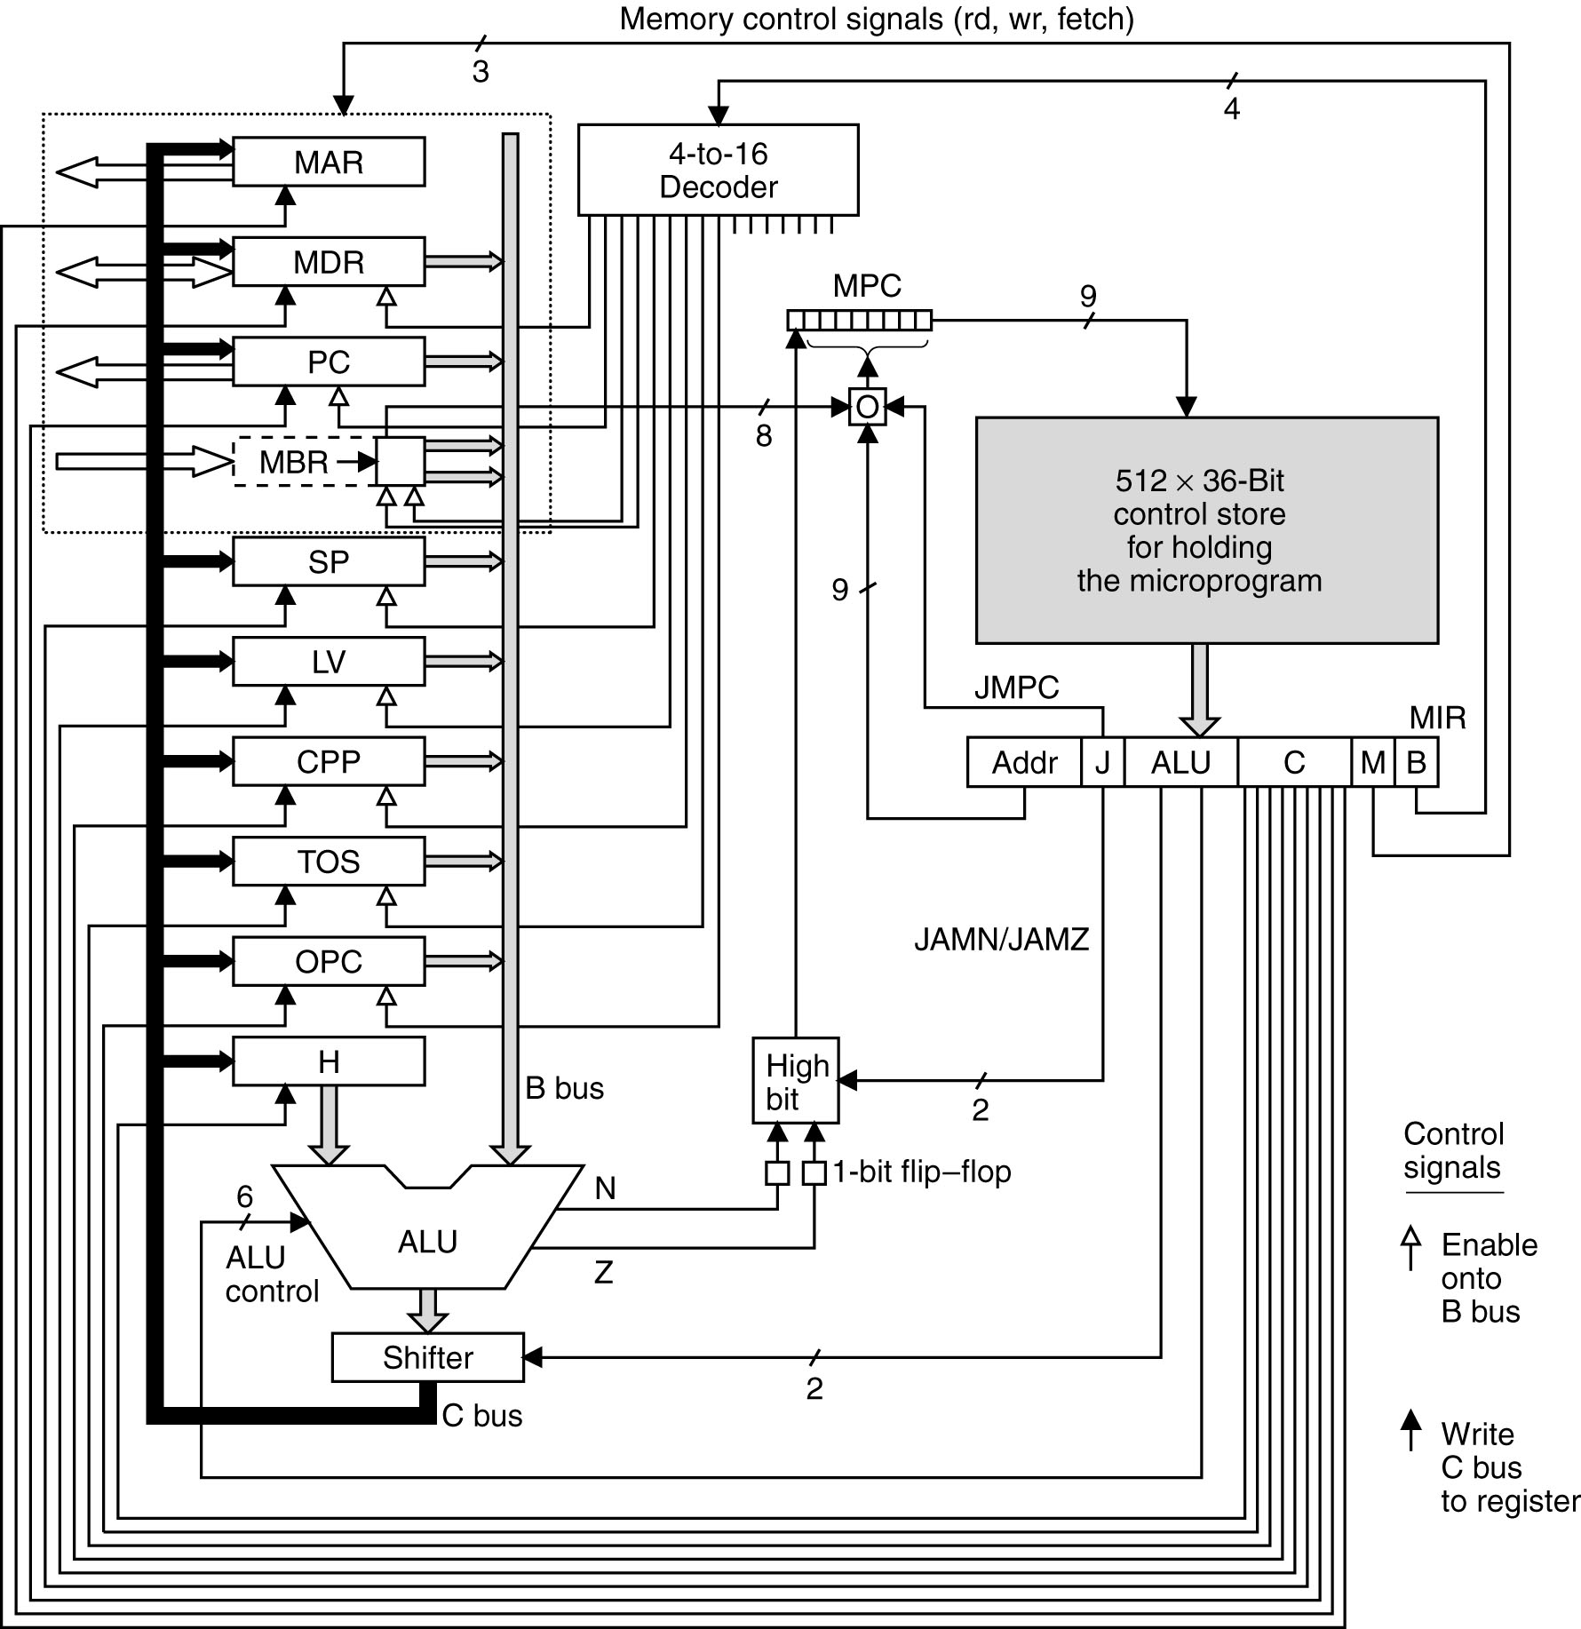
Mic-1
NOP

Slide 48
nop1 goto main1
main1 PC = PC + 1; fetch; goto(MBR)
PC = 1, fetch the first opcode
MBR is still zero
MBR will contain the first opcode at the end of next cycle

Slide 49
Mic-1
NOP

Slide 50
BIPUSH
1
DUP
nop1 goto main1
main1 PC = PC + 1; fetch; goto(MBR)
PC = 2, fetch the second byte (which is operand 1)
MBR = BIPUSH, at the end of nop1
MBR will contain the operand 1 at the end of next cycle

Slide 51
BIPUSH byte
BIPUSH
1
DUP
First attempt
bipush1 SP = MAR = SP + 1
(now MBR = 1)
bipush2 MDR = TOS = MBR; wr; goto main1
main1 PC = PC + 1; fetch; goto(MBR)
Need another cycle before MBR contains next byte (DUP) in the ISA program
Goto (MBR) will go to 1, which is not a lead MI!

Slide 52
BIPUSH byte
Push byte onto stack
bipush1 SP = MAR = SP + 1
bipush2 PC = PC + 1; fetch
bipush3 MDR = TOS = MBR; wr; goto main1
Note: bipush1 = 0x10

Slide 53
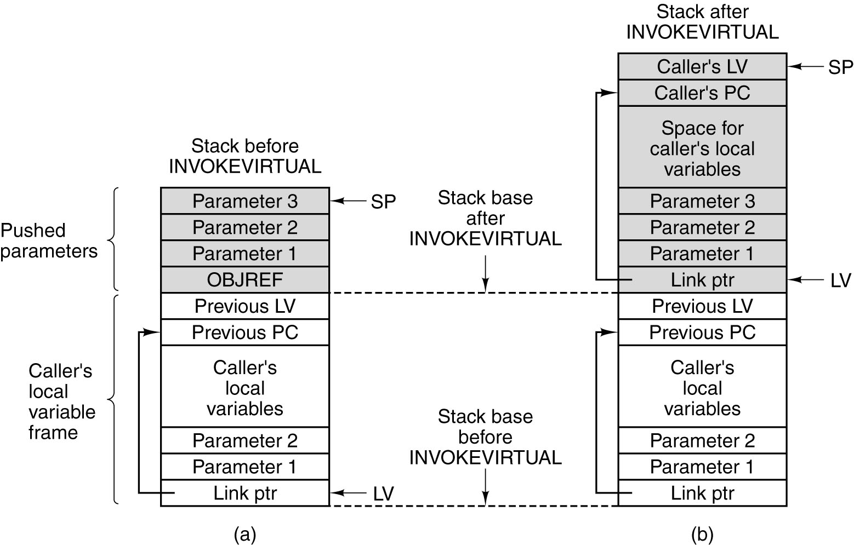
ILOAD varnum
Push local variable onto stack, varnum is one byte (except in the WIDE format)
Local variables and parameters are treated similarly
Variables are referenced by LV + varnum
varnum 0 is OBJREF, which we do not use

Slide 54
ILOAD varnum
Push local variable onto stack, varnum is one byte (except in the WIDE format)
Value of varnum
?
Caller’s LV
SP
Caller’s PC
Value of varnum 2
Value of varnum 1
Link Pointer
LV
Old Stack

Slide 55
ILOAD varnum
Push local variable onto stack, varnum is one byte (except in the WIDE format)
iload1 H = LV
iload2 MAR = MBRU + H; rd
iload3 MAR = SP = SP + 1
iload4 PC = PC + 1; fetch; wr
iload5 TOS = MDR; goto main1
Note: iload1 = 0x15

Slide 56
ISTORE varnum
Pop word from stack and store it in a local variable
istore1 H = LV
istore2 MAR = MBRU + H
istore3 MDR = TOS; wr
istore4 SP = MAR = SP – 1; rd
istore5 PC = PC + 1; fetch
istore6 TOS = MDR; goto main1
Note: istore1 = 0x36

Slide 57

IINC
Add const to local variable, both operands are 1 byte each
The IINC instruction has two different operand fields.

Slide 58
IINC varnum const
Add const to local variable, both operands are 1 byte each
iinc1 H = LV
iinc2 MAR = MBRU + H; rd
iinc3 PC = PC + 1; fetch
iinc4 H = MDR
iinc5 PC = PC + 1; fetch
iinc6 MDR = MBR + H; wr; goto main1
Note: iinc1 = 0x84

Slide 59
GOTO offset
Unconditional branch, offset is 16-bit signed
OPC = address of the GOTO
MBR = 1st byte of offset; Fetch 2nd
Shift signed MBR Left 1 byte
H = 16 bit signed offset
Calculate absolute offset; fetch it for next MI
goto1 OPC = PC – 1
goto2 PC = PC + 1; fetch
goto3 H = MBR << 8
goto4 H = MBRU OR H
goto5 PC = OPC + H; fetch
goto6 goto main1
Note: goto1 = 0xA7

Slide 60
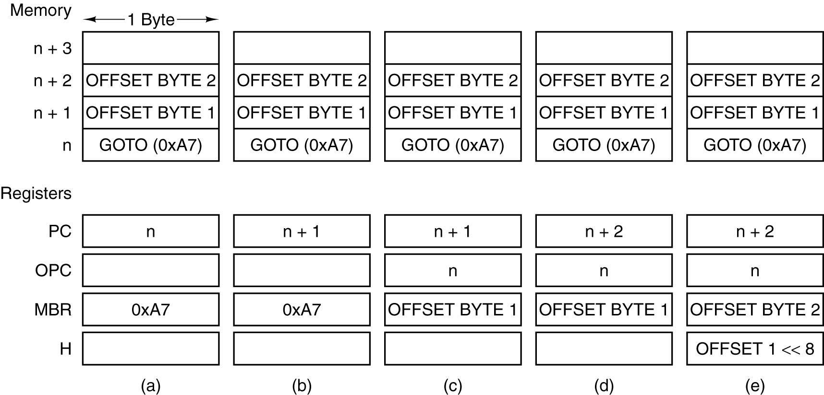
GOTO
The situation at the start of various microinstructions.
a) Main1. b) goto1. c) goto2. d) goto3. e) goto4.

Slide 61
Conditional Branching
MPC[8] = (JAMZ AND Z) OR (JAMN AND N) OR NEXT_ADRRESS[8]
Either:
NEXT_ADDRESS does not change, or
NEXT_ADDRESS[8] is set to 1

Slide 62
IFLT offset
Pop word from stack and branch to offset if < 0
iflt1 MAR = SP = SP – 1; rd
iflt2 OPC = TOS
iflt3 TOS = MDR
iflt4 N = OPC; if (N) goto T; else goto F
Note: iflt1 = 0x9B

Slide 63
iflt1
Read in next-to-top word from stack
iflt1 MAR = SP = SP – 1; rd
NEXT
ADDRESS
iflt2
SP

Slide 64
iflt2
Save top of stack in OPC, before it is lost
iflt2 OPC = TOS
NEXT
ADDRESS
iflt3
TOS

Slide 65
iflt3
MDR now has next-to-top word on stack; this is the new top of the stack
iflt3 TOS = MDR
NEXT
ADDRESS
iflt4
MDR

Slide 66
iflt4
Run OPC through ALU to see if it is 0 (OPC has old top of stack); branch on N
iflt4 N = OPC; if (N) goto T; else goto F
NEXT
ADDRESS
F
OPC

Slide 67
Labels T and F
if (N) goto T; else goto F
MPC[8] = (JAMZ AND Z) OR (JAMN AND N) OR NEXT_ADRRESS[8]
If N = 1, MPC[8] = 1
Else MPC[8] = 0
MPC[0..7] does not change

Slide 68
Labels T & F
if (N) goto T; else goto F
T & F must differ only in the high-order bit
For T it is 1 for F it is 0
Remaining bits are the same

Slide 69
Branching to T
If N = 1
MIR
F
OPC
MPC
AND
N
flipflop
F
OR
High Order Bit
MPC
MPC
1
F
=
T

Slide 70
Branching to F
If N = 0
MIR
F
OPC
MPC
AND
N
flipflop
F
OR
High Order Bit
MPC
MPC
0
F
=
F

Slide 71
F
No need to Branch
F PC = PC + 1; goto F2
F2 PC = PC + 1; fetch; goto F3
F3 goto main1
Skip second offset byte; goto F2
Fetch new opcode

Slide 72
T
Branch to offset
T OPC = PC – 1; goto goto2
Same as goto (OPC = PC – 1 is goto1)
We could have said:
T goto goto1
But this wastes a cycle

Slide 73
GOTO
goto1 OPC = PC – 1
goto2 PC = PC + 1; fetch
goto3 H = MBR << 8
goto4 H = MBRU OR H
goto5 PC = OPC + H; fetch
goto6 goto main1

Slide 74
IFEQ offset
Pop word from stack and branch to offset if it is = 0
ieq1 MAR = SP = SP – 1; rd
ieq2 OPC = TOS
ieq3 TOS = MDR
ieq4 Z = OPC; if (Z) goto T; else goto F
(same as IFLT, but Z is used instead of N)
Note: ifeq1 = 0x99

Slide 75
IF_ICMPEQ offset
Pop 2 words from stack and branch to offset if equal
if_icmpeq1 MAR = SP = SP – 1; rd
if_icmpeq2 MAR = SP = SP – 1
if_icmpeq3 H = MDR; rd
if_icmpeq4 OPC = TOS
if_icmpeq5 TOS = MDR
if_icmpeq6 Z = OPC – H; if (Z) goto T; else goto F
Note: if_icmpeq1 = 0x9F

Slide 76

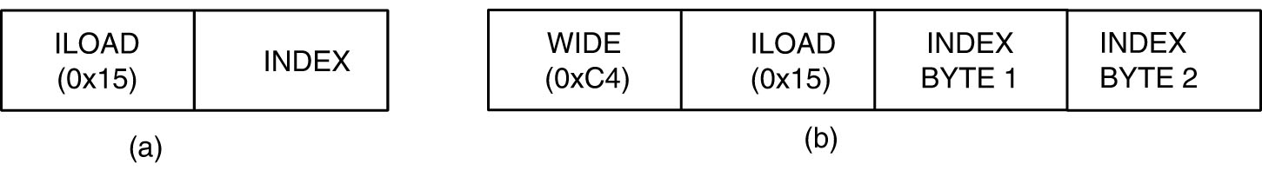
WIDE
The BIPUSH instruction format.
ILOAD with a 1-byte index.
WIDE ILOAD with a 2-byte index.

Slide 77
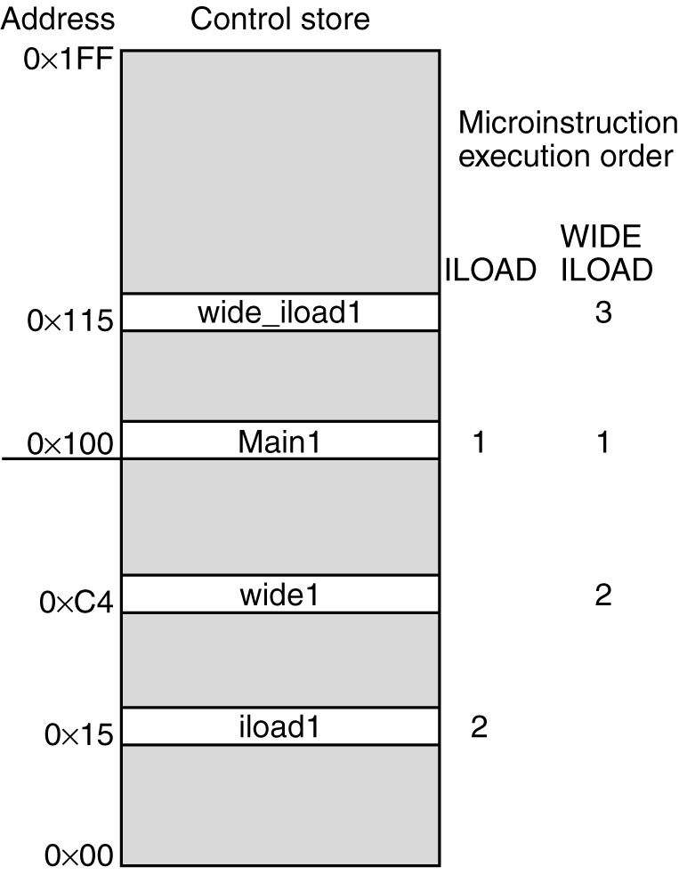
WIDE
The initial microinstruction
sequence for ILOAD
and WIDE ILOAD. The
addresses are examples.

Slide 78
WIDE

Slide 79
WIDE LOAD
Fetch first byte of operand
Goto wide_iload1
Fetch next opr byte

Slide 80
WIDE STORE

Slide 81
LDC_W

Slide 82
Calling INVOKEVIRTUAL
LDC_W OBJREF
INVOKEVIRTUAL noParamMethod
.constant
OBJREF 0x40
.end-constant

Slide 83
Calling INVOKEVIRTUAL
LDC_W OBJREF
ILOAD param
INVOKEVIRTUAL oneParamMethod
.constant
OBJREF 0x40
.end-constant

Slide 84
IVOKEVIRTUAL disp
Invokes another method
disp (16 bit) = position in constant pool that contains the address in method area where method starts
disp
CP
MA
address
Method
invoked

Slide 85
IVOKEVIRTUAL disp
First 4 bytes of a method
First 2: number of parameters, including OBJREF (param 0)
Second 2: size of local variable area
Byte[0] Byte[1] = unsigned 16 bit int
disp
CP
MA
address
0
1
2
Byte[2] Byte[3] = unsigned 16 bit int
3
OPCODE1

Slide 86
INVOKEVIRTUAL

Slide 87
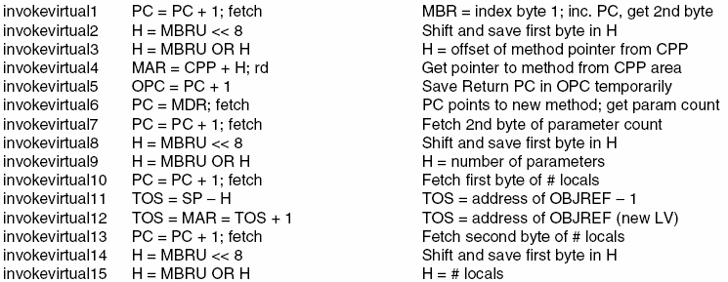
INVOKEVIRTUAL disp

Slide 88
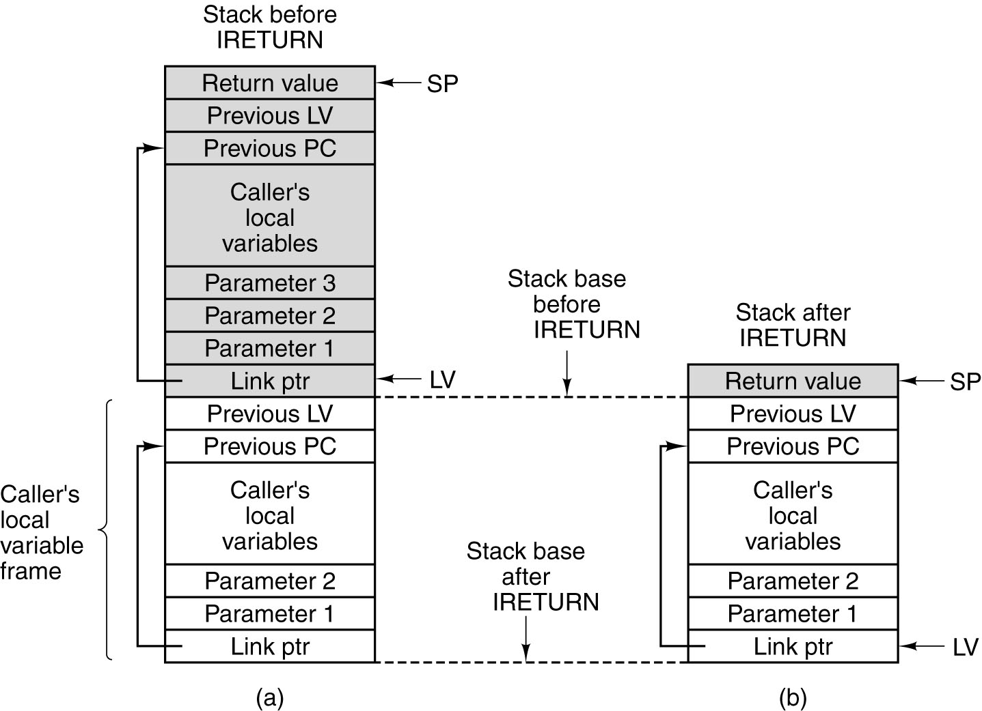
IRETURN

Slide 89
IRETURN

Slide 90
Modifying the microprogram
MMV Example

Slide 91
MMV File Types
JAS: source files containing IJVM ISA
For example ex.jas on BB
IJVM: MMV assembles JAS files to IJVM files
MAL: the microprogram is stored in a MAL file (mic1ijvm.mal)
MIC1: MMV assembles MAL files to MIC1 files
Once JAS or MAL files are assembled, the corresponding IJVM or MIC1 files need only be loaded

Slide 92
Adding MDUP
Add the instruction MDUP byte which works like DUP except that it is repeated byte times
For instance, MDUP 5 duplicates the top of the stack 5 times

Slide 93
1. Write your MAL code
mdup1 PC = PC + 1; fetch; // fetch next opcode
mdup2 OPC = MBR; // save operand
mdup3 N = OPC; if (N) goto myT1; else goto myF1 // if neg quit
mdup4 Z = OPC; if (Z) goto myT2; else goto myF2 // if zero quit
mdup5 SP = MAR = SP + 1 // one more word on the stack
mdup6 MDR = TOS; wr // write TOS to stack
mdup7 OPC = OPC -1; goto mdup4 // dec OPC and repeat
myT1 goto Main1 //quit
myT2 goto Main1 //quit
myF1 goto mdup4 //continue
myF2 goto mdup5 //continue

Slide 94
1. Write your MAL code
Do not skip line numbers
Like mdup1, mdup3, without mdup2
No need for implicit goto
mdup1 PC = PC + 1; fetch; goto mdup2
mdup2 OPC = MBR;
Keep in mind that “True” and “False” labels must be 10000000 apart
Microassembler takes care of this
Use new labels
No need

Slide 95
2. Optimize your MAL code
mdup1 PC = PC + 1; fetch; // fetch next opcode
mdup2 OPC = MBR; // save operand
mdup3 N = OPC; if (N) goto myT1; else goto myF1 // if neg quit
mdup4 Z = OPC; if (Z) goto myT2; else goto myF2 // if zero quit
mdup5 SP = MAR = SP + 1 // one more word on the stack
mdup6 MDR = TOS; wr // write TOS to stack
mdup7 OPC = OPC -1; goto mdup4 // dec OPC and repeat
myT1 goto Main1 replace with PC = PC + 1; fetch; goto (MBR)
myT2 goto Main1 replace with PC = PC + 1; fetch; goto (MBR)
myF1 goto mdup4 replace with Z = OPC; if (Z) goto myT2; else goto myF2
myF2 goto mdup5 replace with SP = MAR = SP + 1 ; goto mdup6
myT1 goto Main1
myT2 goto Main1
myF1 goto mdup4

Slide 96
3. Add your code to mic1ijvm.mal
Code can be added after any instruction that ends with an explicit goto
MDUP now needs a numeric value for the opcode
Add it at the beginning of the file as
.label mdup1 0x01
Use any hex value that is not in use

Slide 97
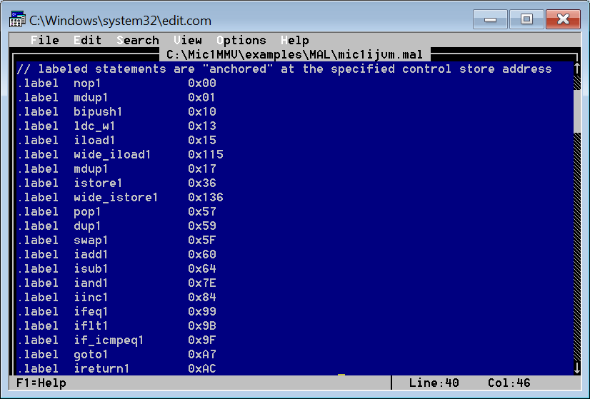
3. Add your code to mic1ijvm.mal

Slide 98
4. Modify ijvm.conf
Add:
0x01 MDUP byte // duplicates the top of the stack byte times
Anywhere in the file

Slide 99
5. Assemble the Microcode
Run MMV from a directory that contains ijvm.conf
From MMV, load/Assemble MAL file
Choose mic1ijvm.mal
[if there are errors MMV will tell you]
Load (effectively loading mic1ijvm.mic1)

Slide 100
5. Assemble the Microcode (NOTES)
You may get a Java.lang.NullPointerException or Java.lang.Exception when assembling some MAL code in MMV. Two things can help you recover from these, which I have learned the hard way: 1. Make sure there is an empty line at the end of you MAL file 2. If your code contains multi-way branching (if-else), add your code gradually to the MAL file as follows: (a) Add all microinstrcutions (MI) that precede the next MI that has if-else. (So this chunk you have just added does not have any if-else MIs). Compile this part alone and correct any errors before proceeding. (b) add the following if-else MI, compile, and correct errors.
GOTO (a) until all MIs have been added to the MAL file

Slide 101
6. Write a JAS tester
Such as:
.main
start:
BIPUSH 0x1
MDUP 2
BIPUSH 0x2
MDUP 5
.end-main

Slide 102
7. Load/Assemble JAS file
From MMV, load/assemble JAS file
Choose the tester file
Run the program

